Slide 1
20240913 Condensed matter physics: from magnetism to quantum spin liquid I
Sophia University Ryui Kaneko （金子隆威）
https://github.com/ryuikaneko/lecturenote_2024_condmat

Slide 2
Self introduction
Ryui Kaneko（金子 隆威）
Born in Tokyo, raised in Saitama
Academic career
2009 Tokyo Institute of Technology [bachelor]
2011 Tokyo University [master]
2014 Tokyo University [doctor]
2014-2023 Goethe University (Germany), NIMS, ISSP, Kindai University [postdoc]
2023 Waseda University [associate professor]
2024 Sophia University [associate professor]
Research interest
CondMat, StatMech, ComputationalPhys, …
Magnetism, spin liquid, superconductivity, critical phenomena, tensor network, variational Monte Carlo, …

Slide 3
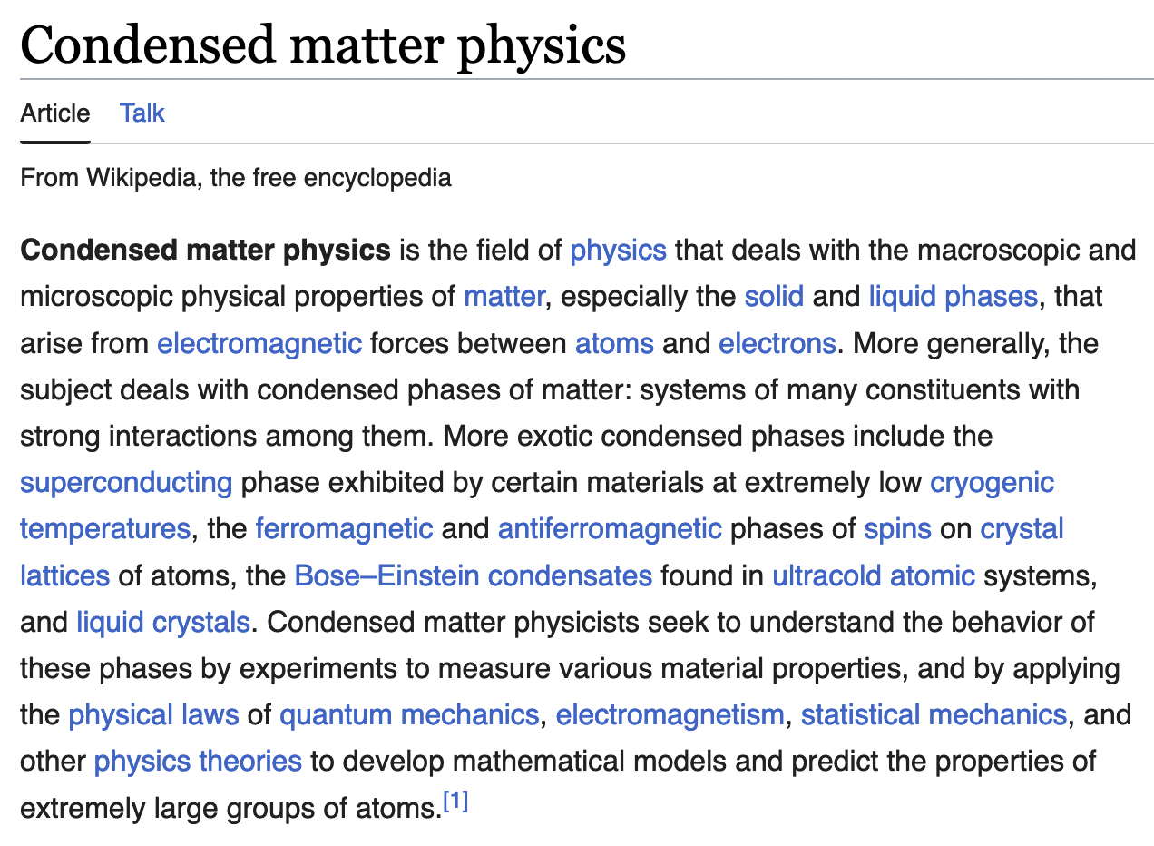
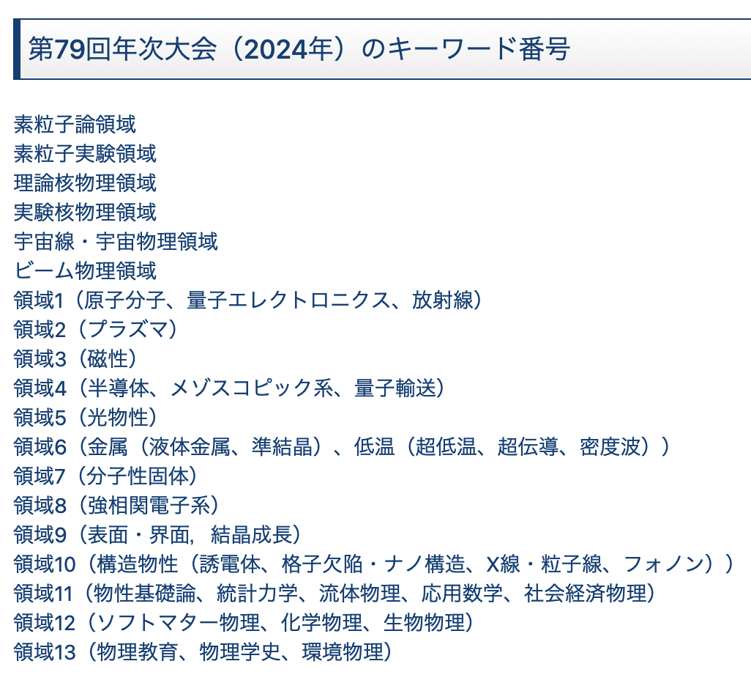
What is condensed matter physics?
凝縮系物理、固体物理、物性物理、… in Japanese
Focus on magnetism today and tomorrow
From Wikipedia
From JPS meeting （日本物理学会）
atom, molecular, optical physics
magnetism
semiconductor
metal
superconductor, density wave
strongly correlated electron systems
statistical mechanics

Slide 4
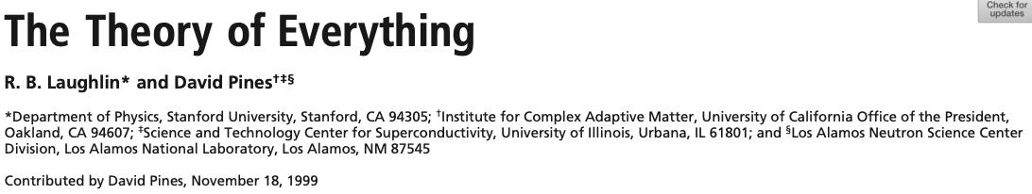
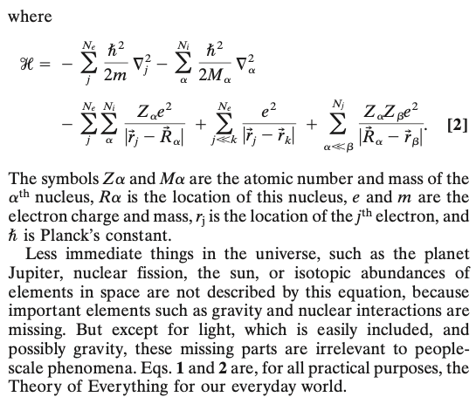
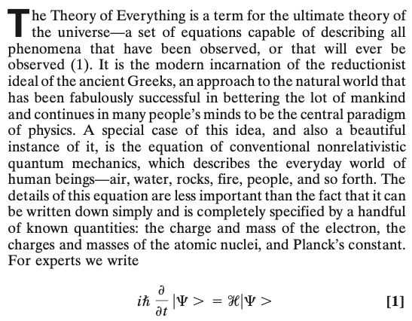
How to describe everything for our everyday world
Except cosmology, general relativity,
particle physics, …

Slide 5
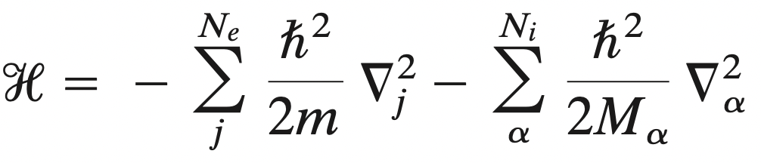
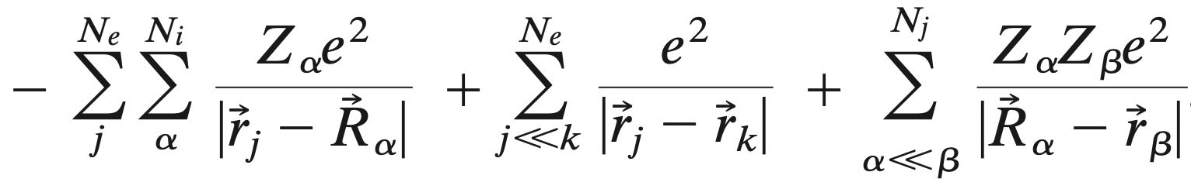
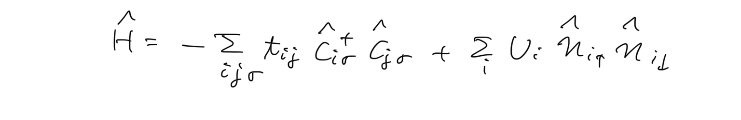
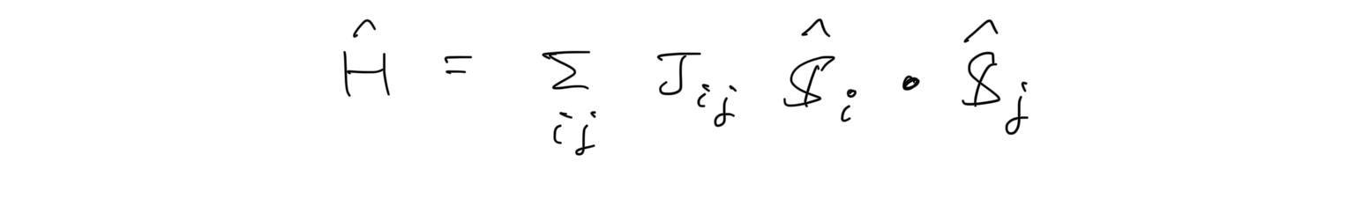
Rough outline
Hamiltonian for electrons in atoms
Hubbard model
Heisenberg model
magnetism, quantum spin liquid, …

Slide 6
Rough outline
Hamiltonian for electrons in atoms
Hubbard model
spin and charge degrees of freedom
Heisenberg model
spin degrees of freedom
magnetism, quantum spin liquid, …

Slide 7
Outline
Brief review of itinerant electron systems
Electrons in crystals
Second quantization
Hubbard models
Solving models for simple cases
Noninteracting and atomic limits
Mean-field approximation
Exact diagonalization (2 sites)
→ Strong coupling limit: Heisenberg model (spin system)
Magnetism and quantum spin liquid
Spin models
Frustrated magnetism and quantum spin liquid
Kitaev honeycomb spin liquid

Slide 8
Rough outline
Hamiltonian for electrons in atoms
Second quantization
Hubbard model
Heisenberg model
magnetism, quantum spin liquid, …

Slide 9
Rough outline
Hamiltonian for electrons in atoms
Second quantization
Hubbard model
References
A. L. Fetter, J. D. Walecka, Quantum Theory of Many-Particle Systems
F. H. L. Essler et al., The One-Dimensional Hubbard Model
Sebastian Will, PhD thesis, https://www.physics.utoronto.ca/~jht/pub/theses/Will2011.pdf
Autumn School on Correlated Electrons: Simulating Correlations with Computers 20-24 September 2021, https://www.cond-mat.de/events/correl21/manuscripts/correl21.pdf
猪木慶治, 川合光, 量子力学1・2
今田正俊, 統計物理学
Heisenberg model
magnetism, quantum spin liquid, …

Slide 10
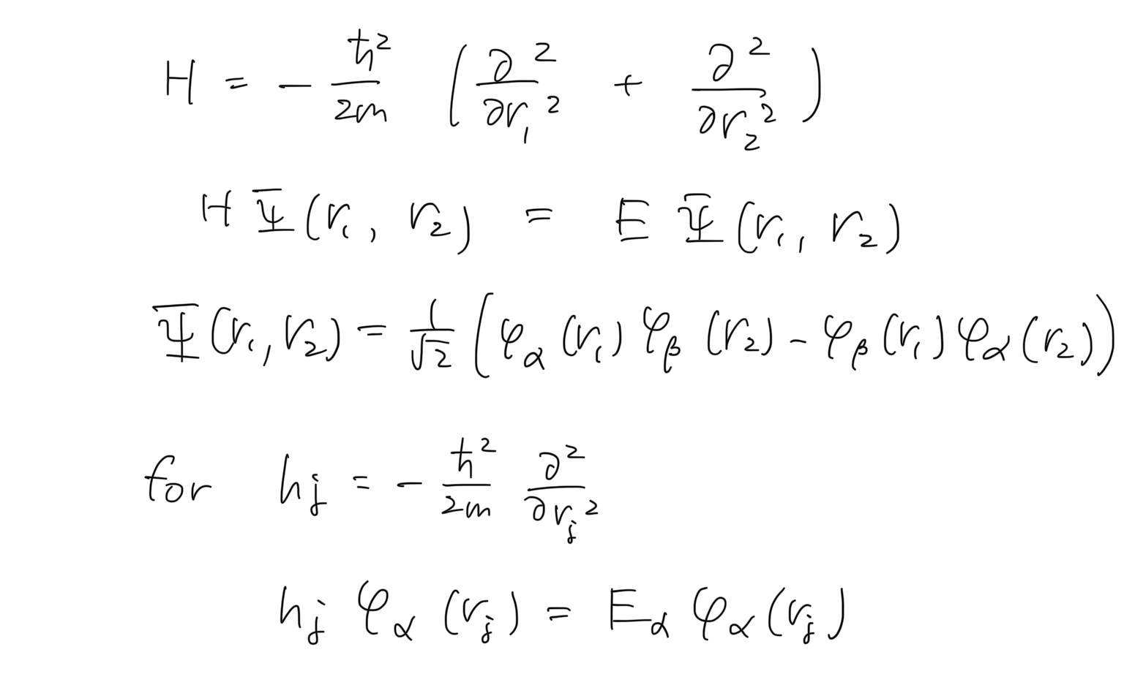
For simplicity, consider 2 free electrons
Solve the eigenvalue problem and antisymmetrize the wave function for fermion
φ_{α}(r) is defined as

Slide 11
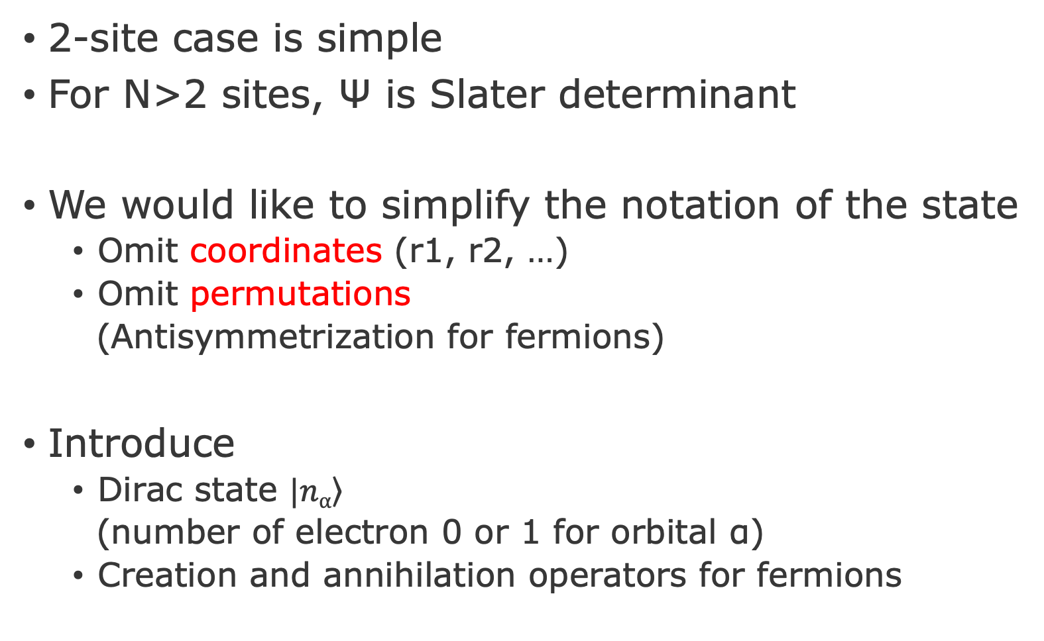
Motivation: Simplify the notation
2-site case is simple
For N>2 sites, Ψ is Slater determinant
We would like to simplify the notation of the state
Omit coordinates (r1, r2, …)
Omit permutations
(Antisymmetrization for fermions)
Introduce
Dirac state $\left.|nα\right\rangle$
(number of electron 0 or 1 for orbital α)
Creation and annihilation operators for fermions

Slide 12
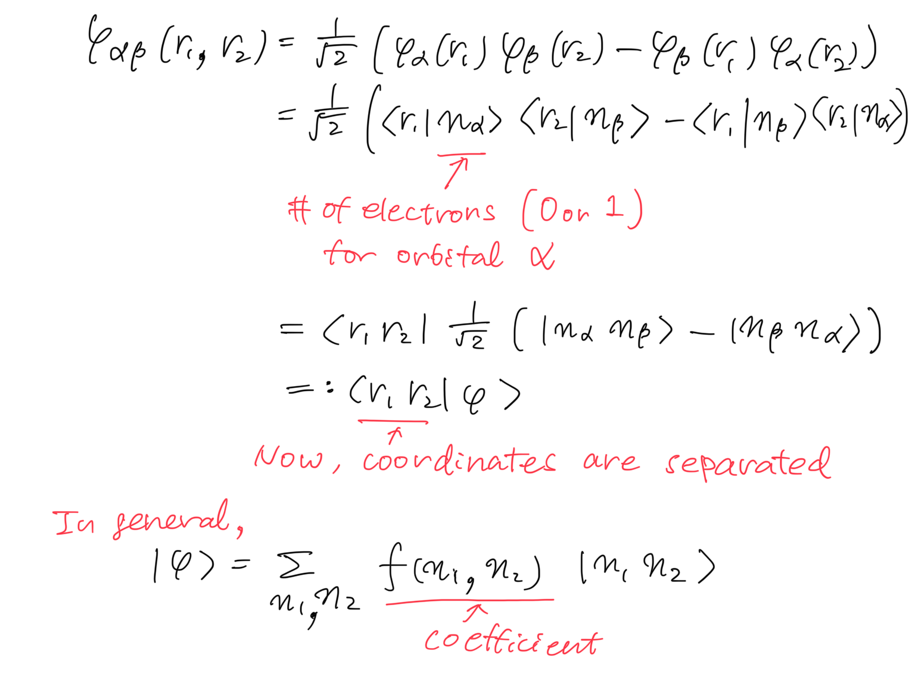
Remove coordinate

Slide 13
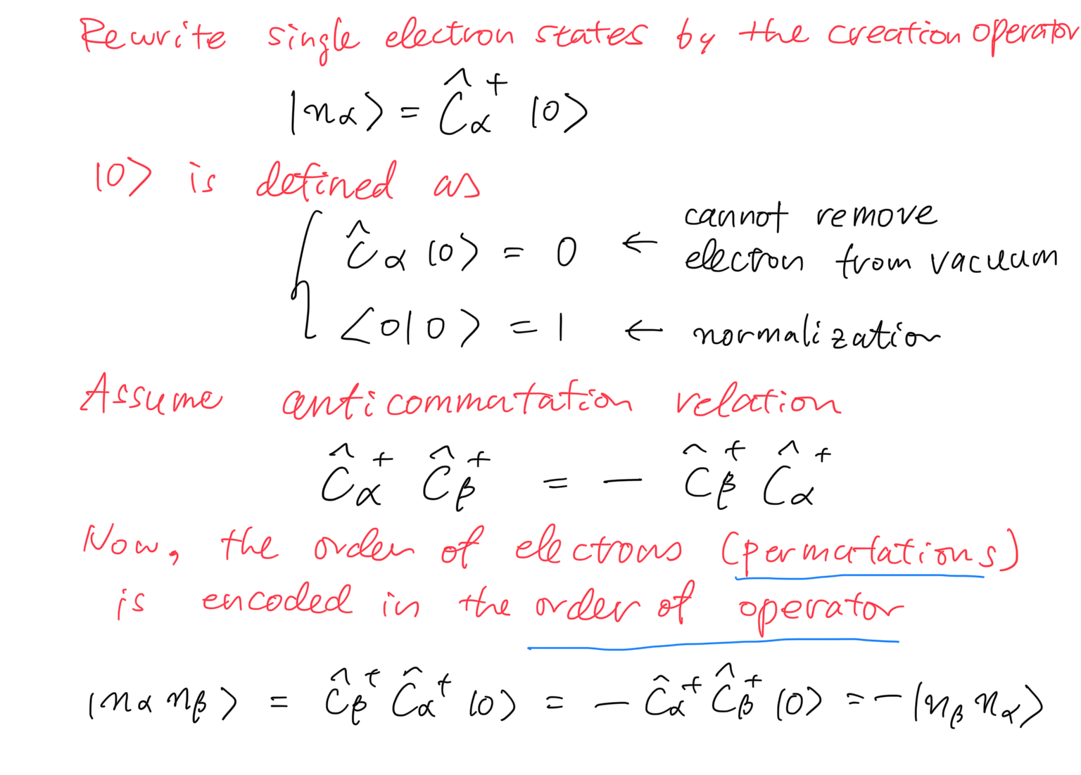
Permutation → Commutator

Slide 14
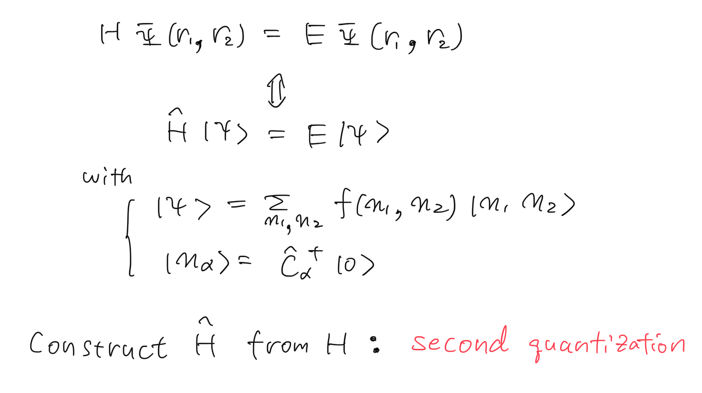
Construct operator $\hat{H}$ from H
But how?

Slide 15
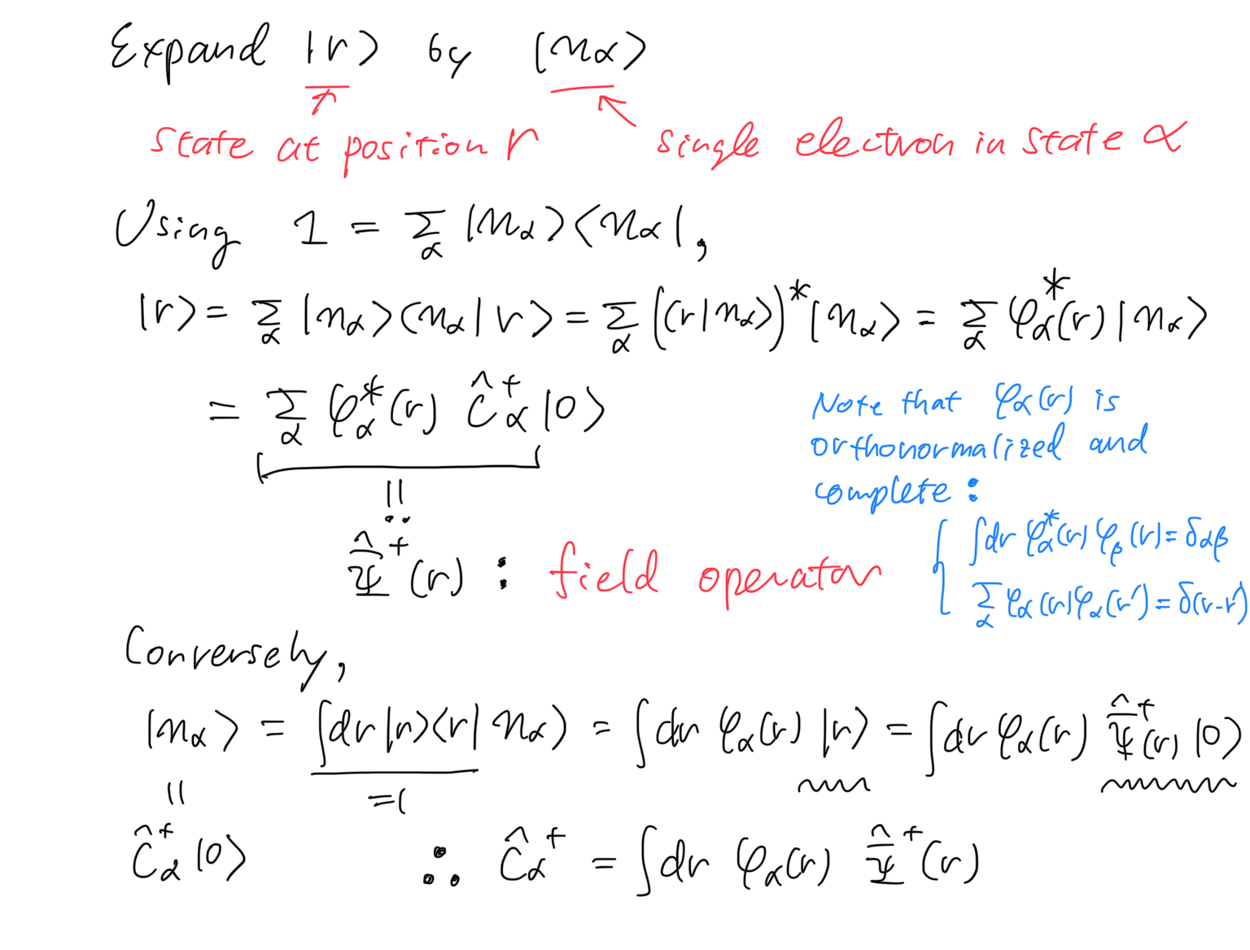
Preparation: Introduce field operator

Slide 16
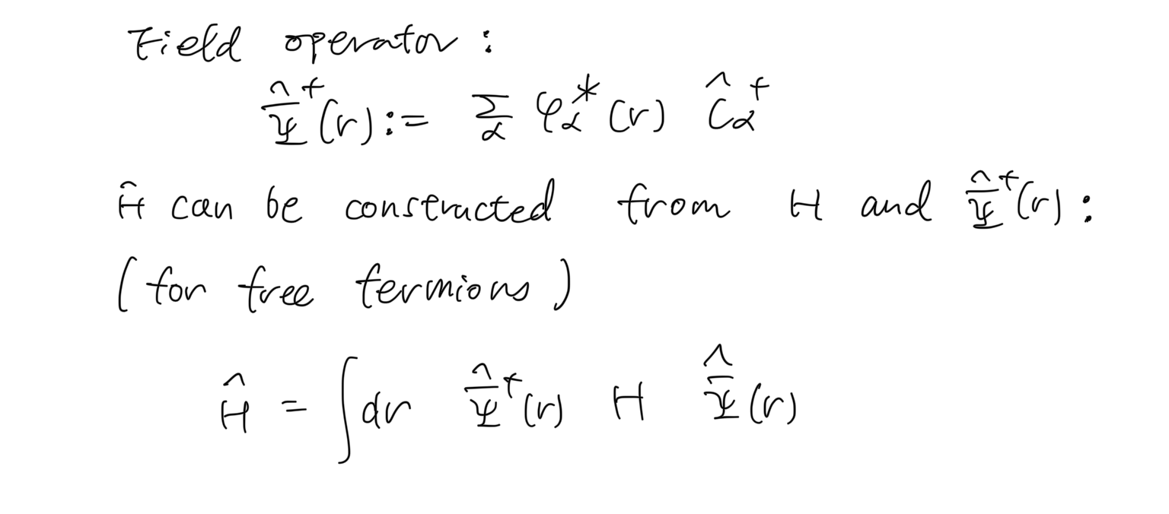
Second quantized Hamiltonian

Slide 17
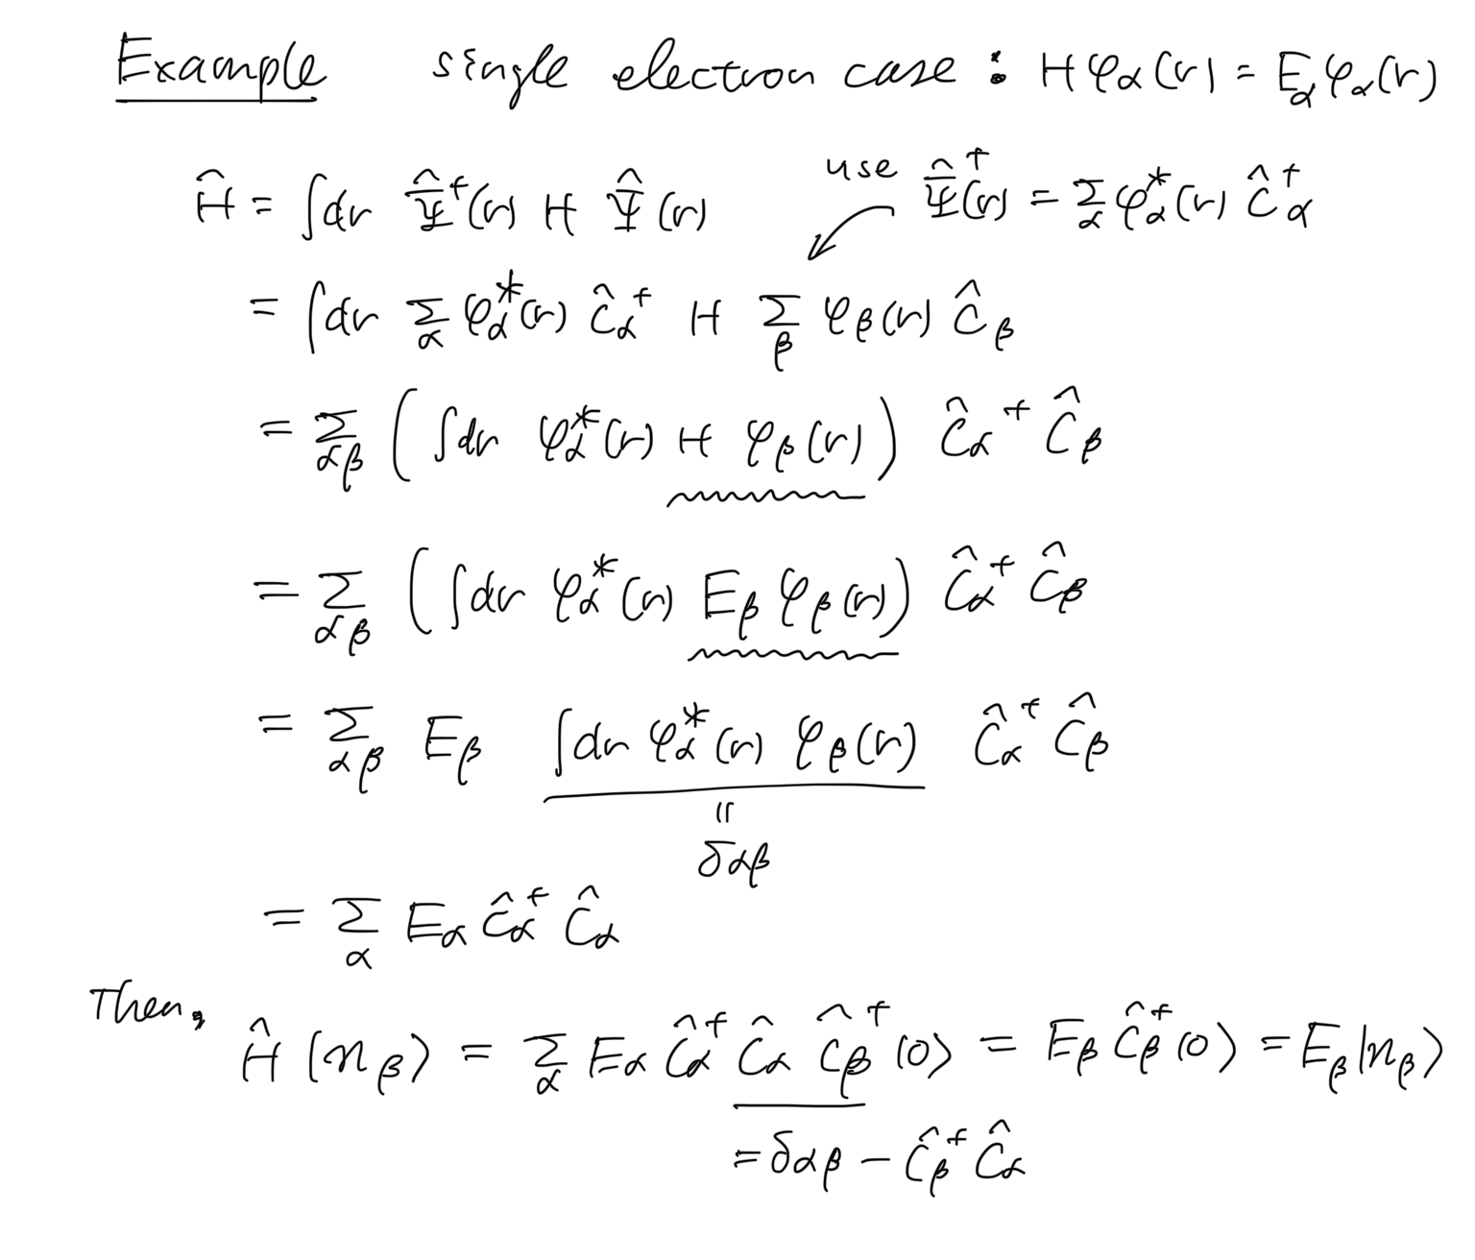
Check by taking an example

Slide 18
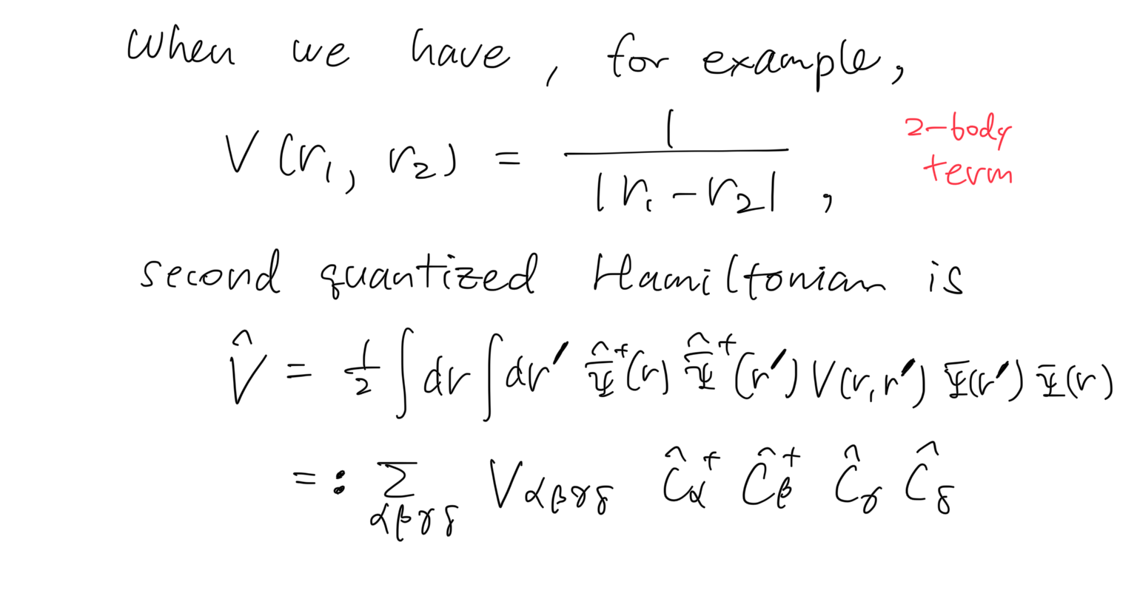
Second quantize 2-body interaction

Slide 19
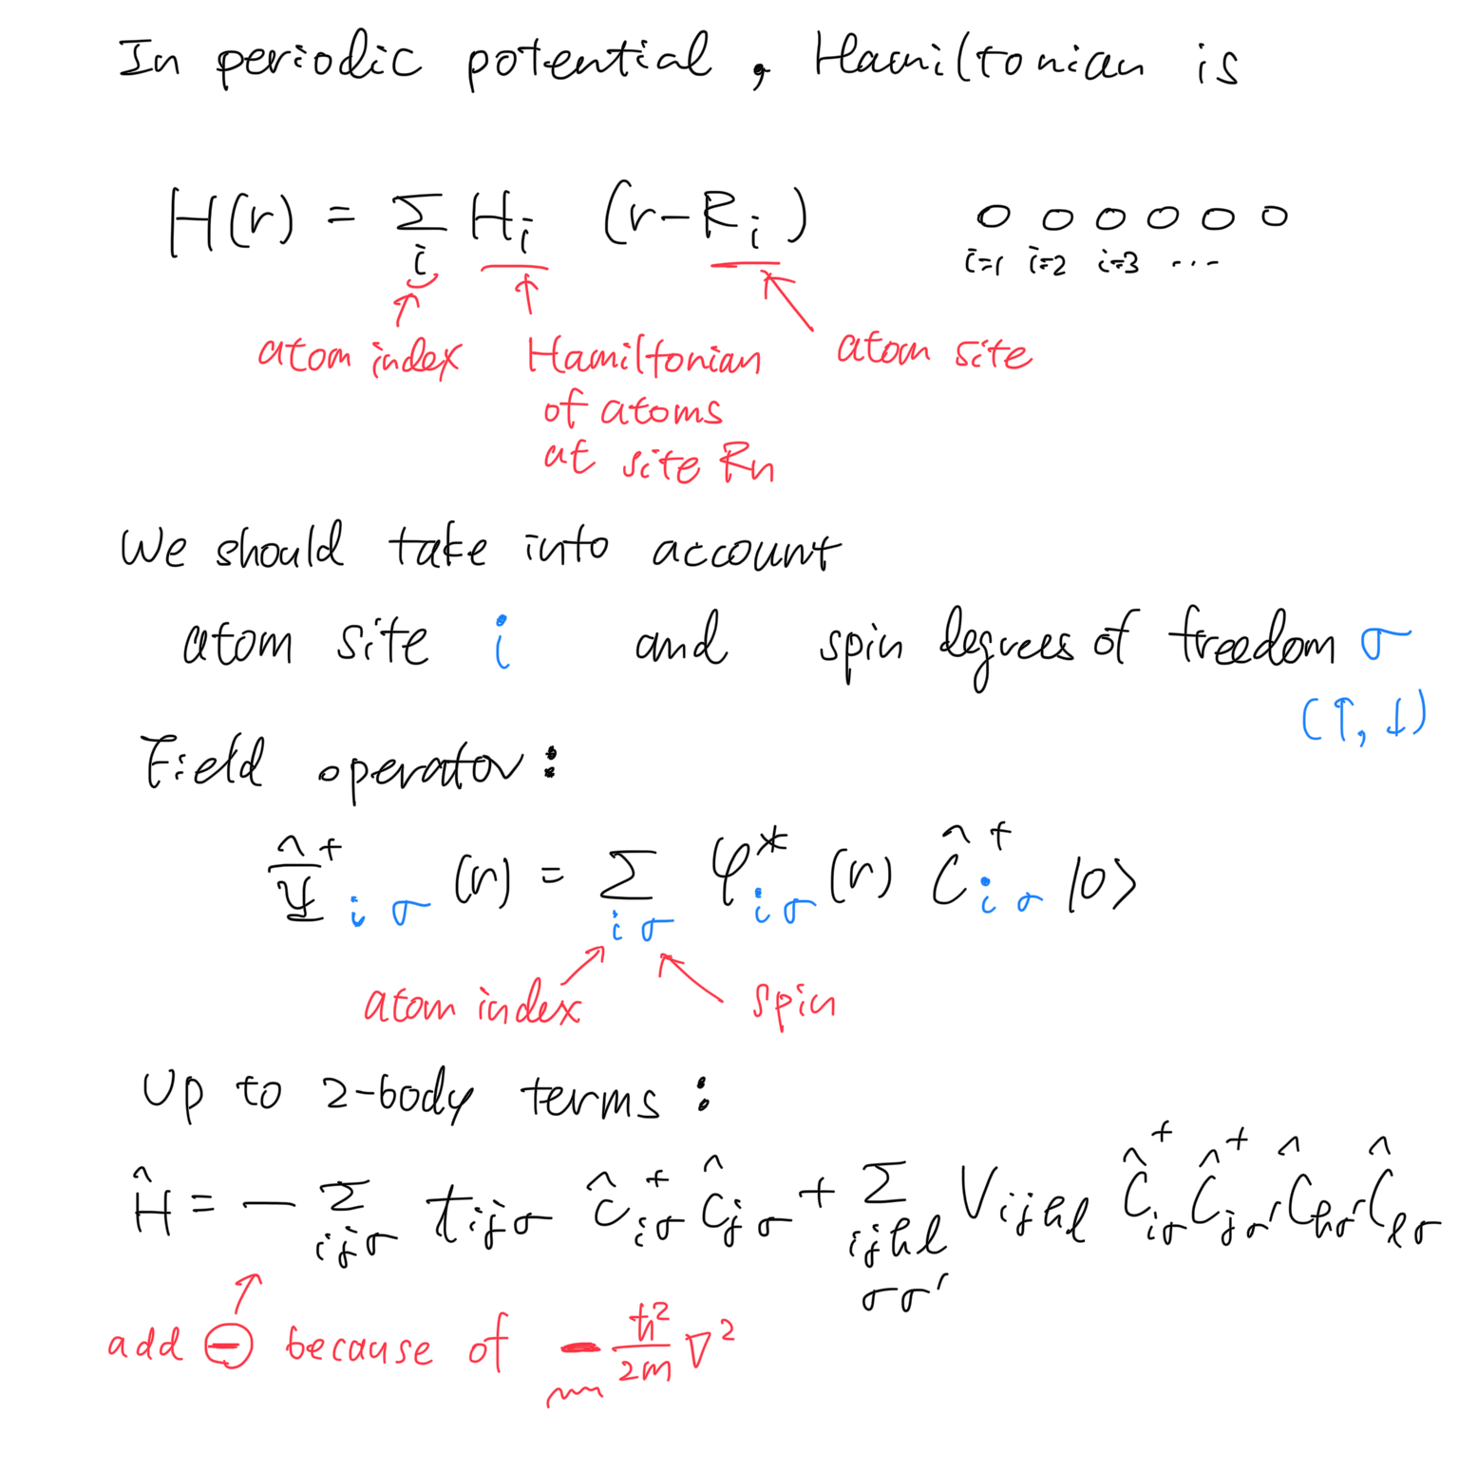
Hamiltonian in crystals

Slide 20
Hamiltonian in crystals

Slide 21
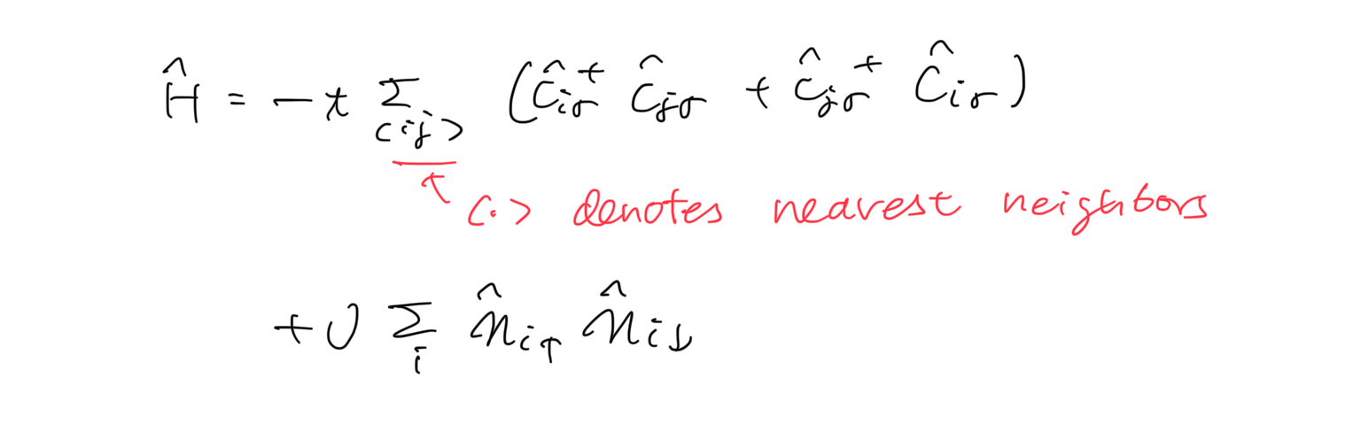
Further simplification → Hubbard model
To further simplify the model, consider
Nearest neighbor i,j for t_{ij}
→ t_{ij}=:t for |i-j|=1
Onsite i,j,k,l for V_{ijkl}
→ V_{iiii}=:U
We finally obtain the Hubbard model

Slide 22
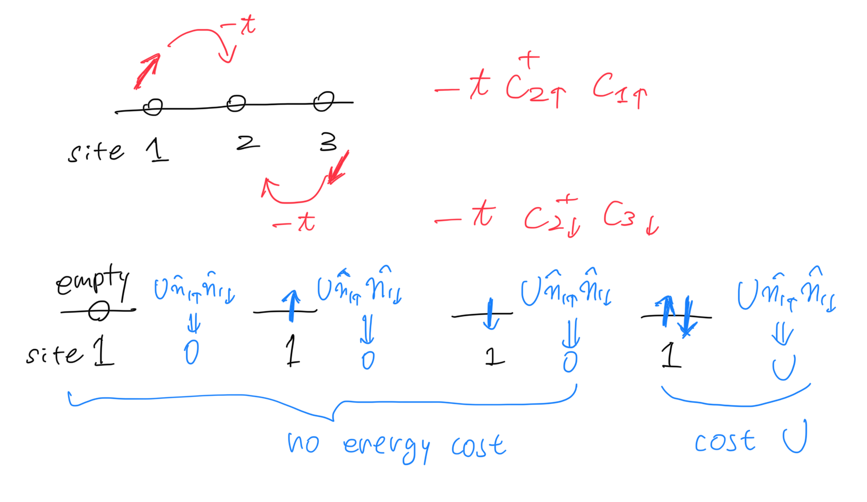
Hubbard model

Slide 23
Rough outline
Hamiltonian for electrons in atoms
Hubbard model
Heisenberg model
magnetism, quantum spin liquid, …

Slide 24
Several limits / Solve by approximation
U=0 limit (noninteracting limit)
Tight-bonding model, free fermion system
t=0 limit
Atomic limit
Mean-field approximation
Antiferromagnetic order for bipartite lattices
2-site model
Relation to the spin model (Heisenberg model)

Slide 25
Several limits / Solve by approximation
U=0 limit (noninteracting limit)
Tight-bonding model, free fermion system
t=0 limit
Atomic limit
Mean-field approximation
Antiferromagnetic order for bipartite lattices
2-site model
Relation to the spin model (Heisenberg model)

Slide 26
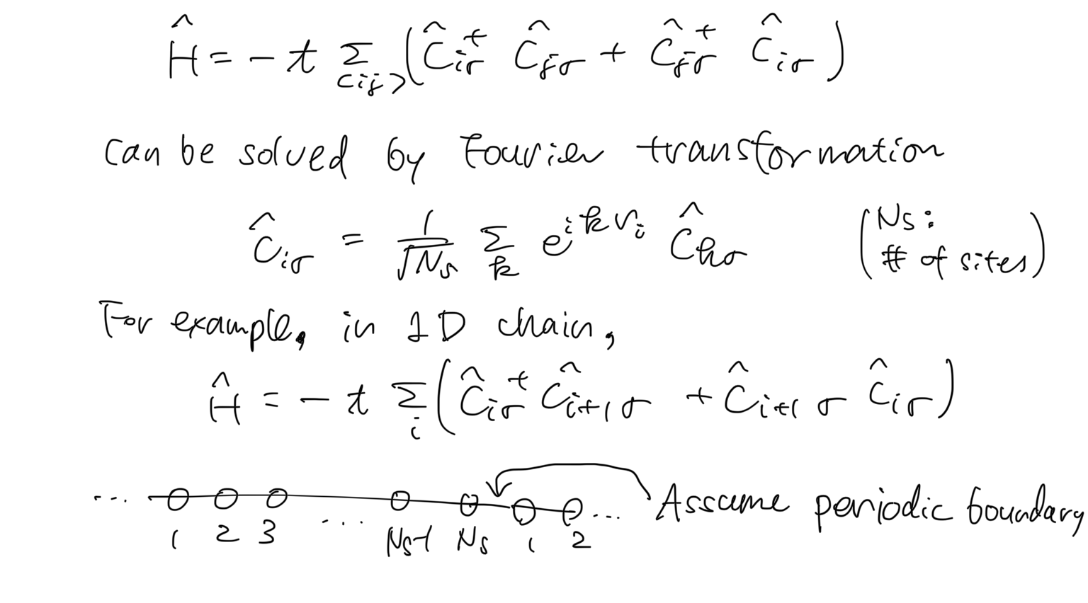
Noninteracting limit (U=0)

Slide 27
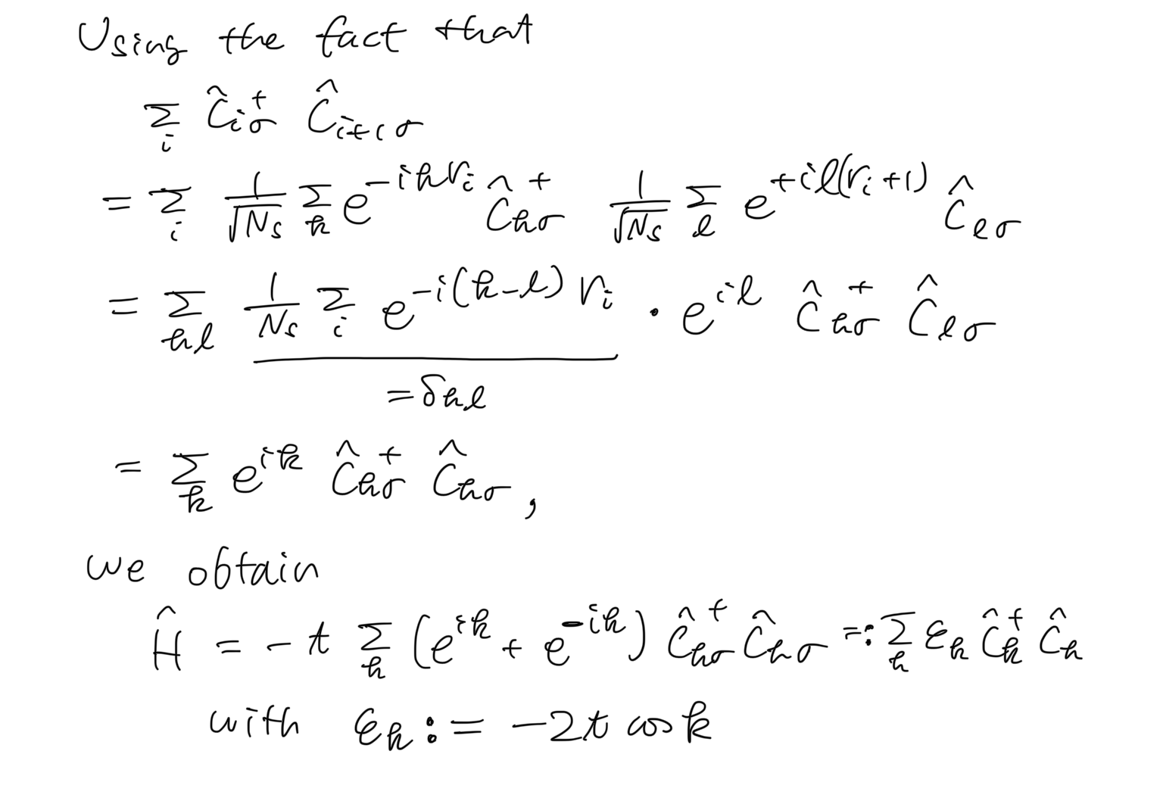
Noninteracting limit (U=0)

Slide 28
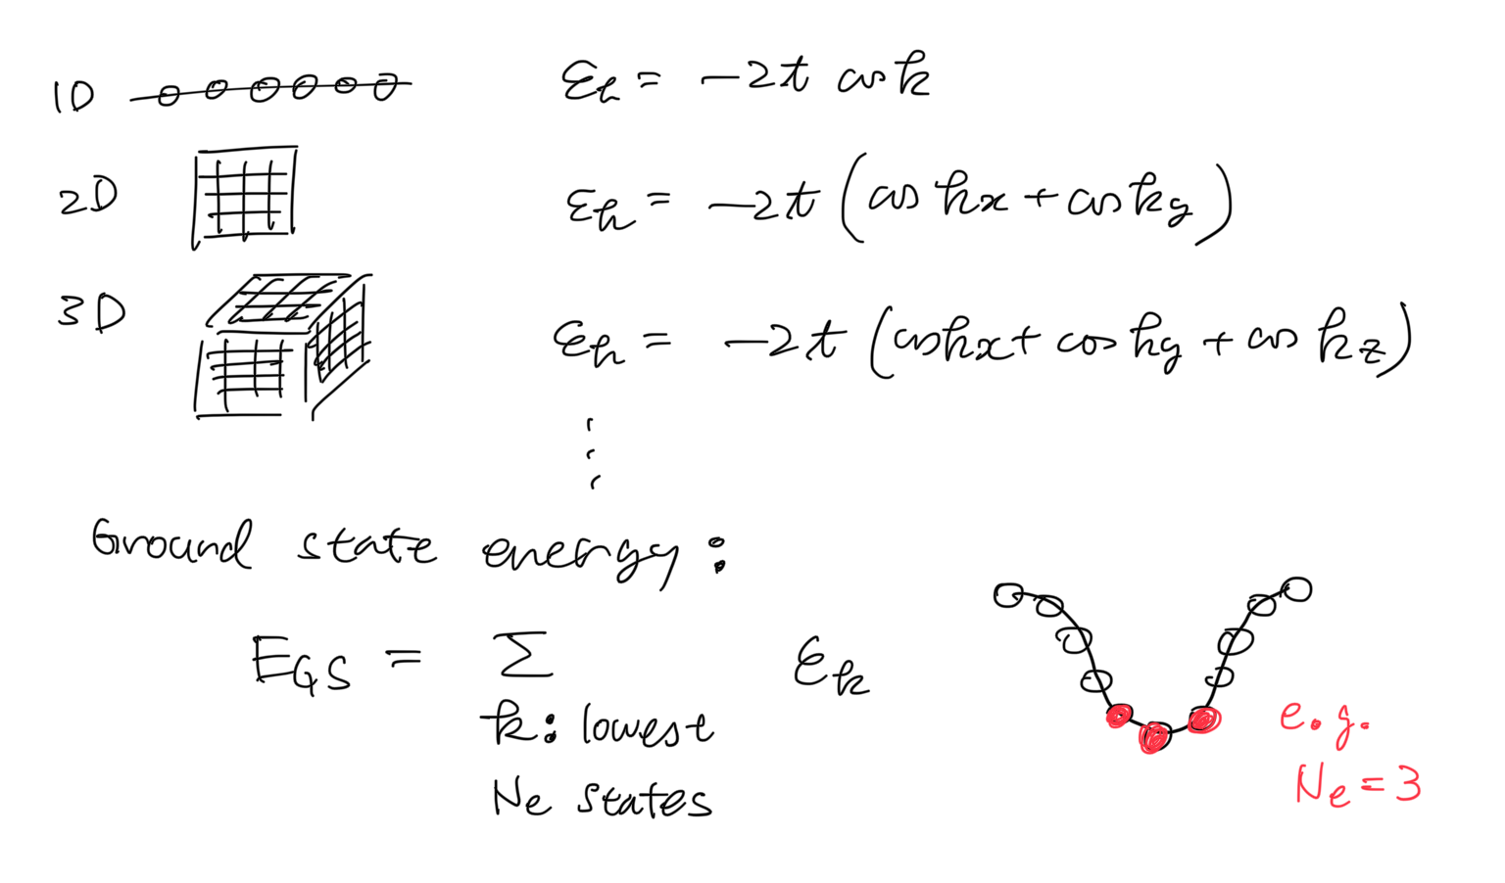
Noninteracting limit (U=0)

Slide 29
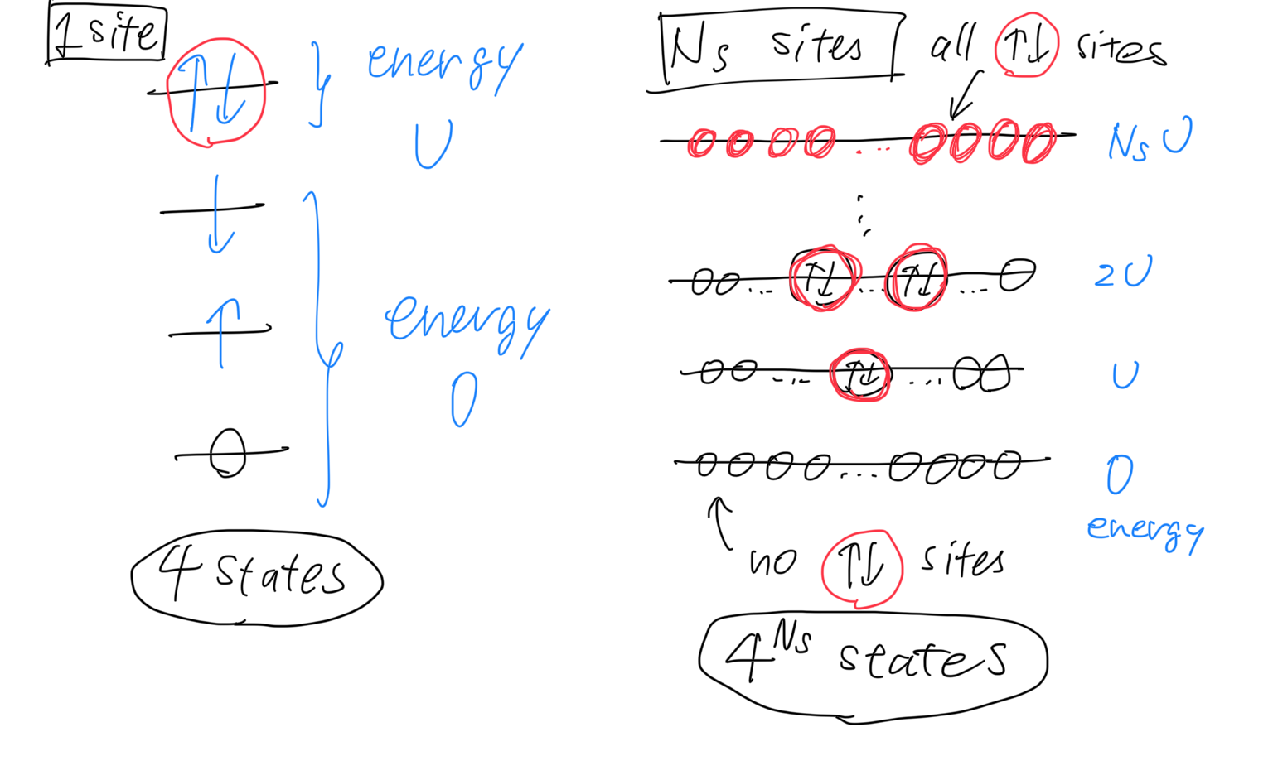
Atomic limit (t=0)

Slide 30
Several limits / Solve by approximation
U=0 limit (noninteracting limit)
Tight-bonding model, free fermion system
t=0 limit
Atomic limit
Mean-field approximation
Antiferromagnetic order for bipartite lattices
2-site model
Relation to the spin model (Heisenberg model)

Slide 31
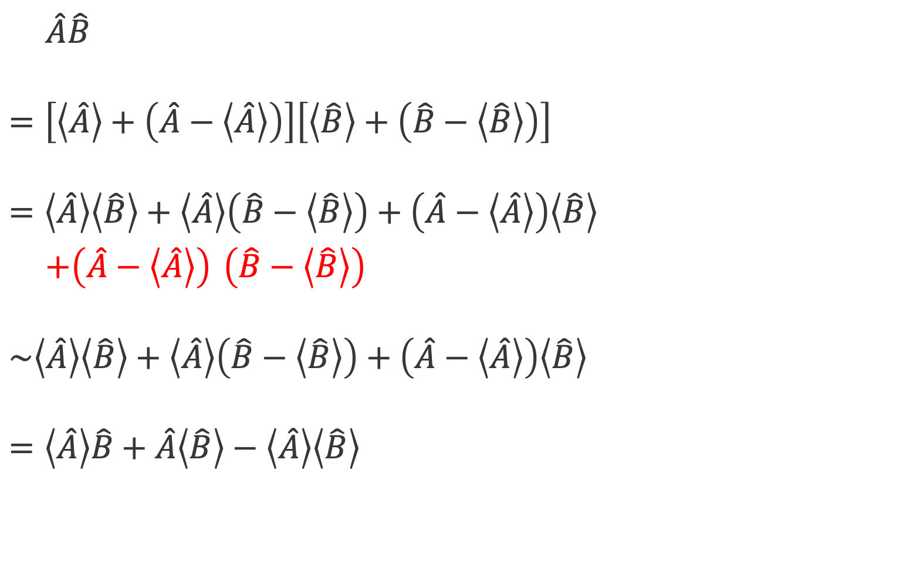
Mean-field (MF) approximation
$\hat{A}\hat{B}$
$$=\left[\left\langle \hat{A}\right\rangle +\left(\hat{A}−\left\langle \hat{A}\right\rangle \right)\right]\left[\left\langle \hat{B}\right\rangle +\left(\hat{B}−\left\langle \hat{B}\right\rangle \right)\right]$$
$$=\left\langle \hat{A}\right\rangle \left\langle \hat{B}\right\rangle +\left\langle \hat{A}\right\rangle \left(\hat{B}−\left\langle \hat{B}\right\rangle \right)+\left(\hat{A}−\left\langle \hat{A}\right\rangle \right)\left\langle \hat{B}\right\rangle$$
$+\left(\hat{A}−\left\langle \hat{A}\right\rangle \right)$ $\left(\hat{B}−\left\langle \hat{B}\right\rangle \right)$
$$\sim \left\langle \hat{A}\right\rangle \left\langle \hat{B}\right\rangle +\left\langle \hat{A}\right\rangle \left(\hat{B}−\left\langle \hat{B}\right\rangle \right)+\left(\hat{A}−\left\langle \hat{A}\right\rangle \right)\left\langle \hat{B}\right\rangle$$
$$=\left\langle \hat{A}\right\rangle \hat{B}+\hat{A}\left\langle \hat{B}\right\rangle −\left\langle \hat{A}\right\rangle \left\langle \hat{B}\right\rangle$$
Throw away fluctuations!

Slide 32
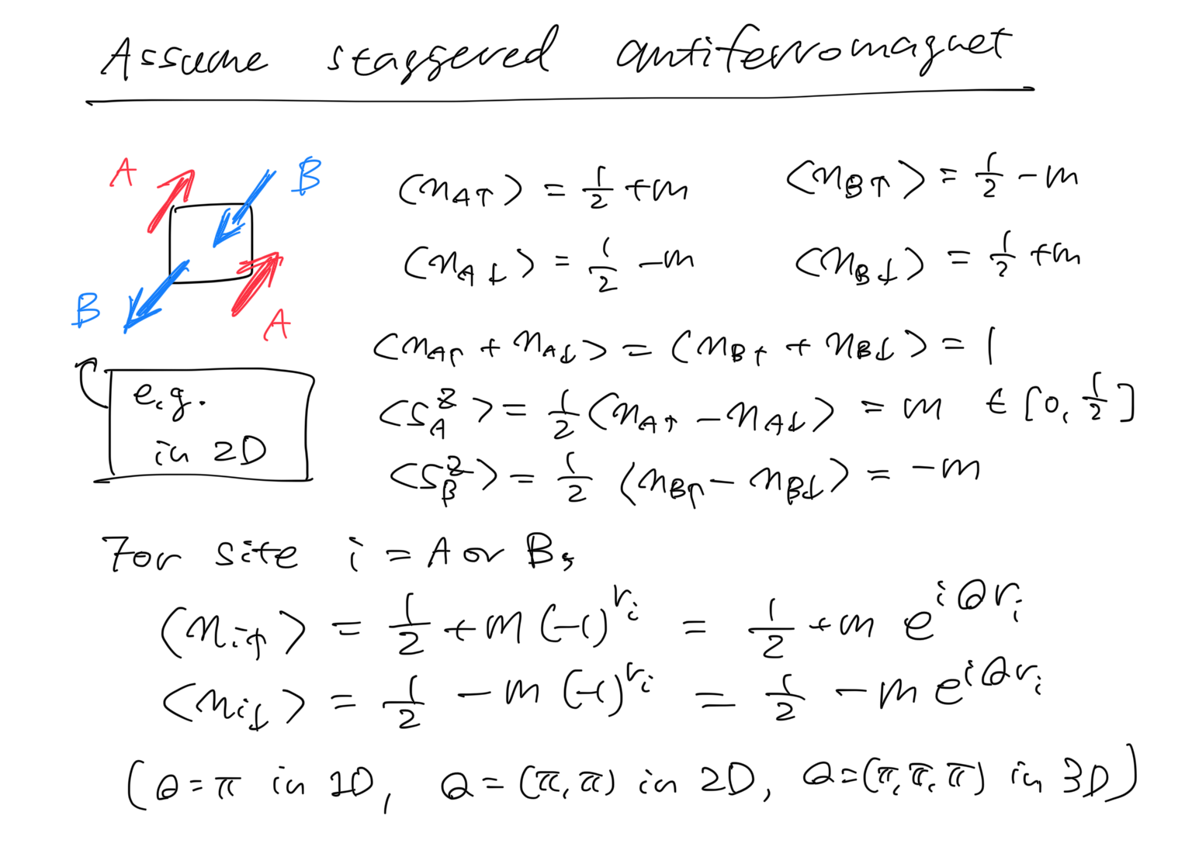
Mean-field (MF) approximation
Focus on the case
Number of sites N_{s} = Number of electrons N_{e}
Often called “half filling” (because N↑=N↓=N_{s}/2)
For hypercubic lattices (chain, square, cube, …), the ground state can be calculated (numerically exactly), and it shows
Apply MF approx. to check antiferromagnetism
long-range antiferromagnetic order for 2D, 3D, 4D, …
quasi-long-range antiferromagnetic order for 1D

Slide 33
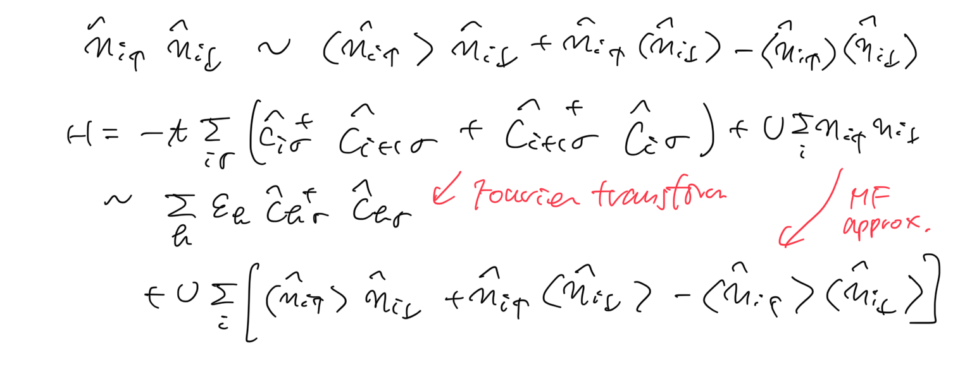
Mean-field (MF) approximation

Slide 34
Mean-field (MF) approximation

Slide 35
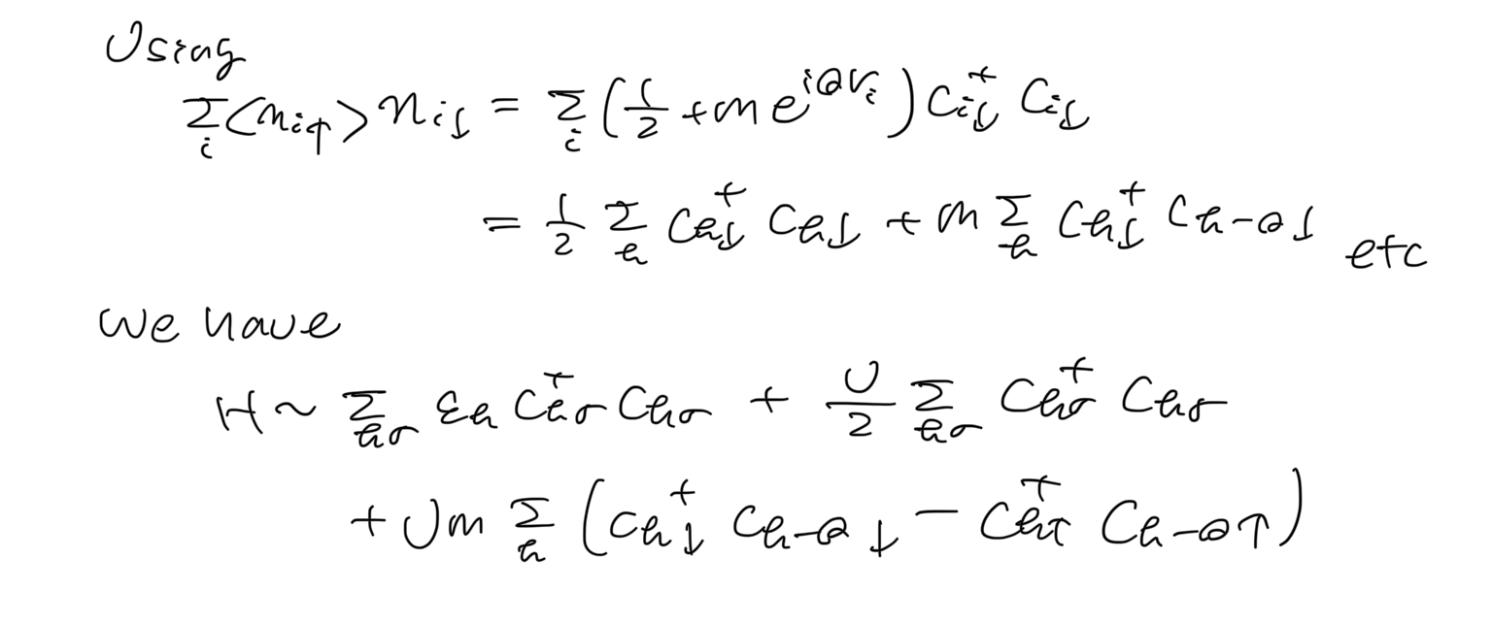
Mean-field (MF) approximation
(up to constant terms)

Slide 36
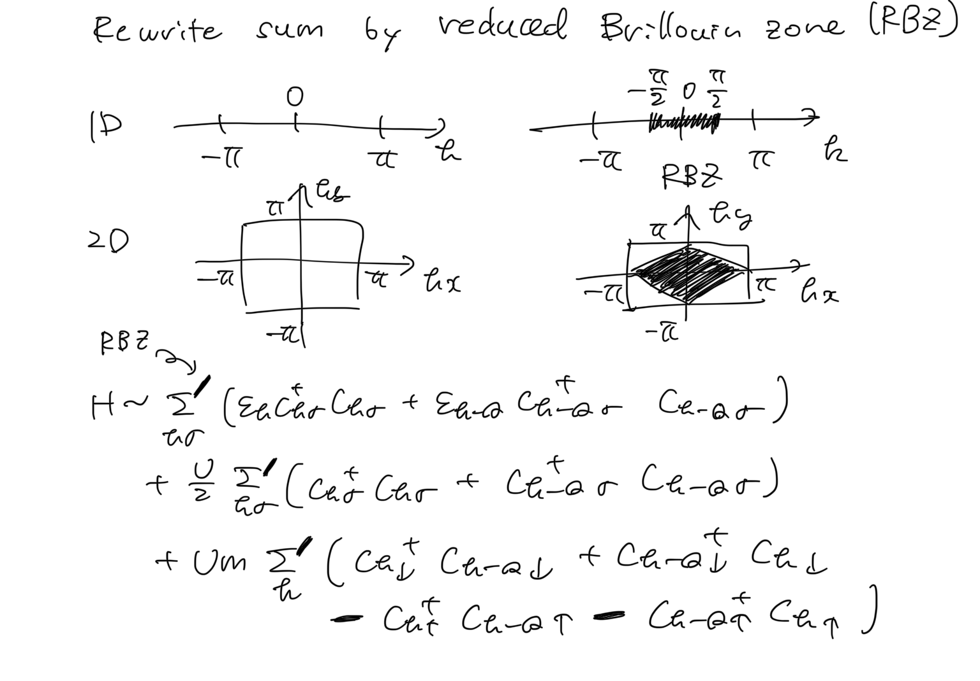
Mean-field (MF) approximation

Slide 37
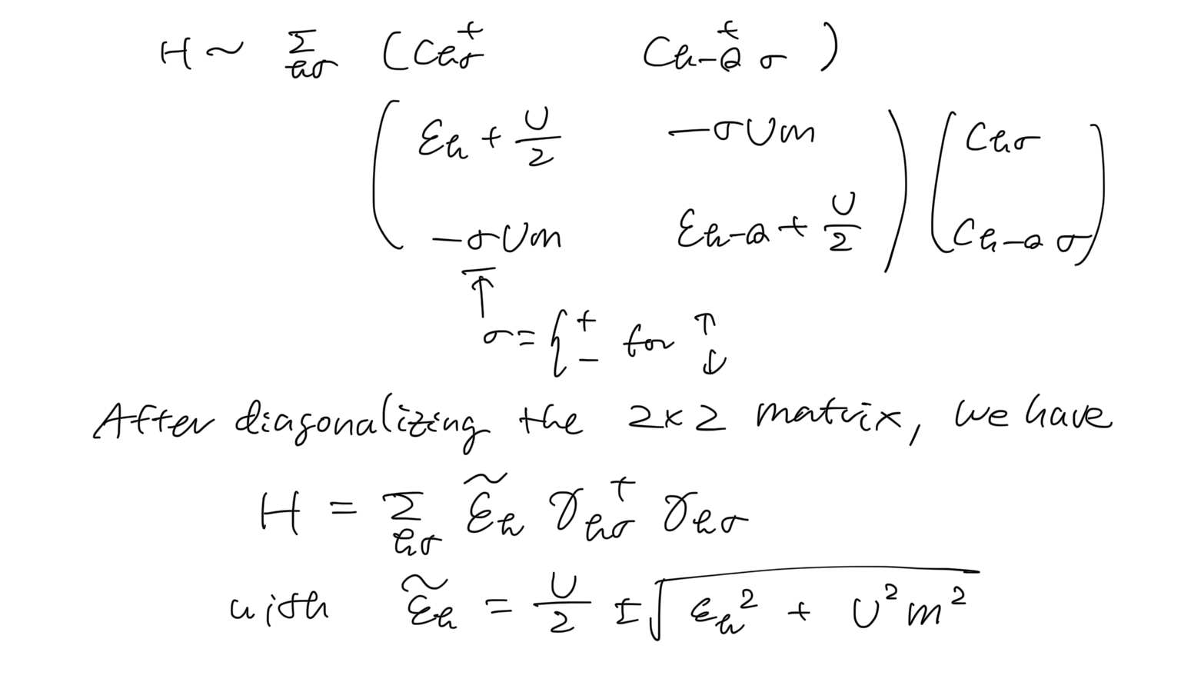
Mean-field (MF) approximation

Slide 38
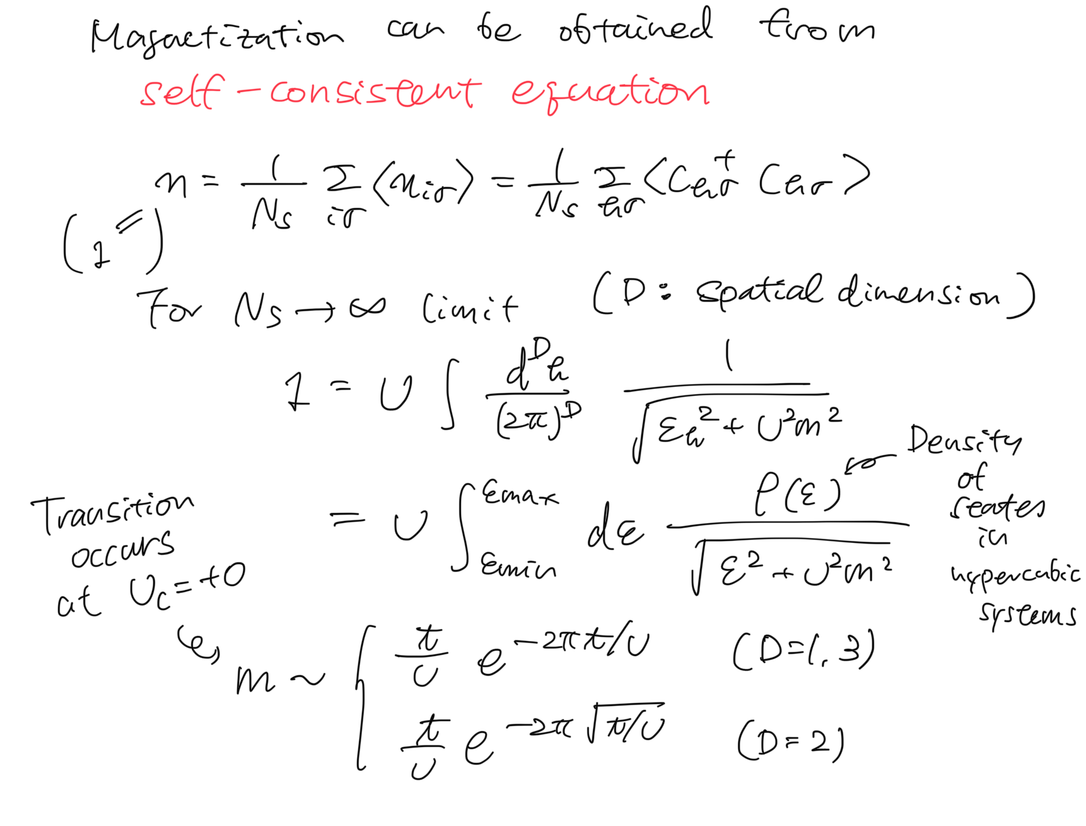
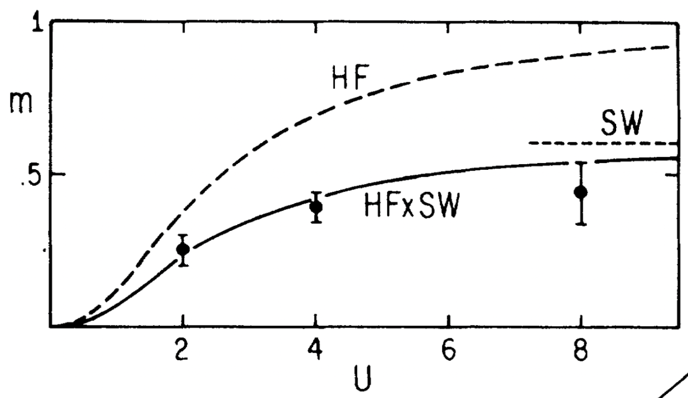
Mean-field (MF) approximation
Mean-field
U_{c}=0
Numerically exact
(quantum Monte Carlo)
J. E. Hirsch, PRB.31.4403(’85)
J. E. Hirsch and S. Tang, PRL.62.591(’88)

Slide 39
Several limits / Solve by approximation
U=0 limit (noninteracting limit)
Tight-bonding model, free fermion system
t=0 limit
Atomic limit
Mean-field approximation
Antiferromagnetic order for bipartite lattices
2-site model
Relation to the spin model (Heisenberg model)

Slide 40
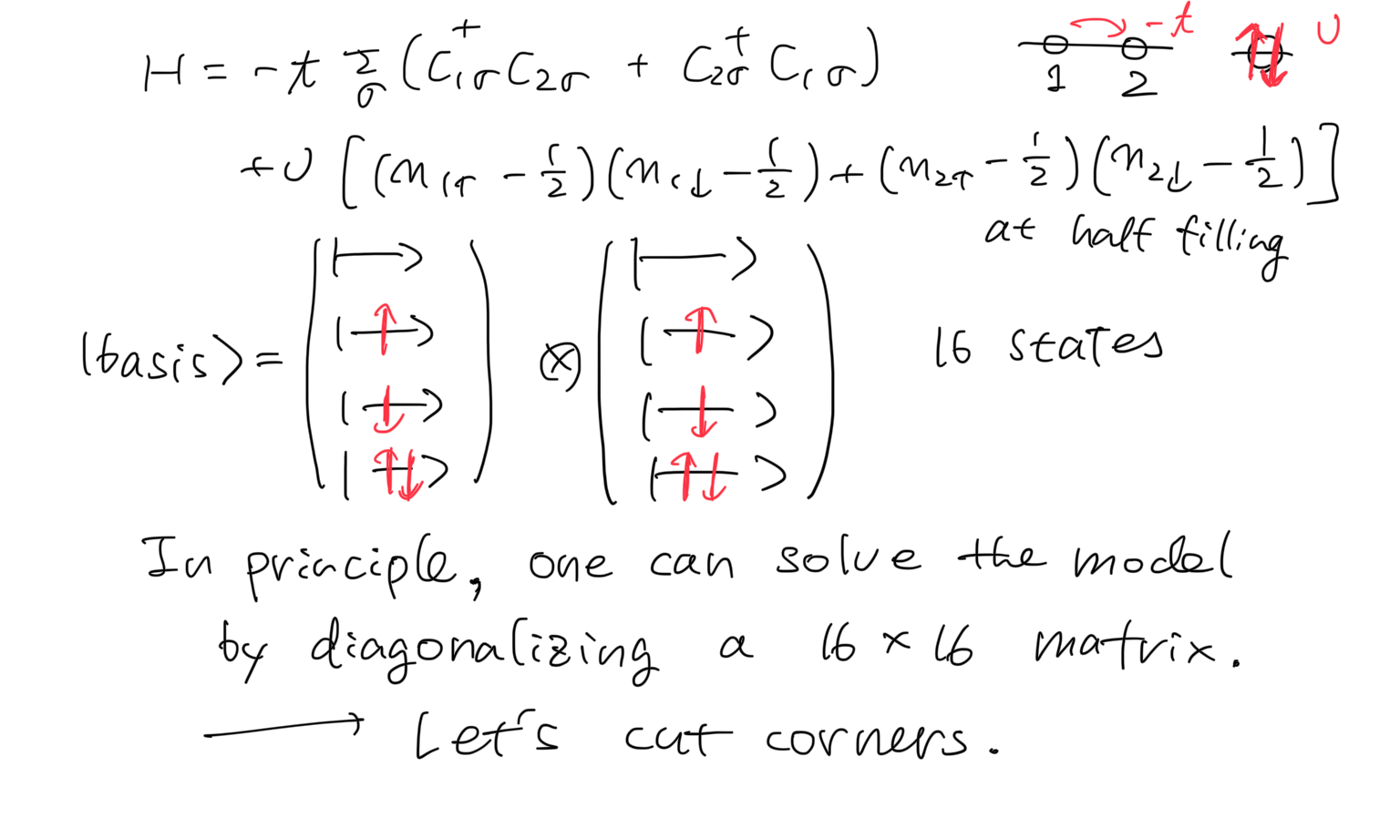
2-site Hubbard model

Slide 41
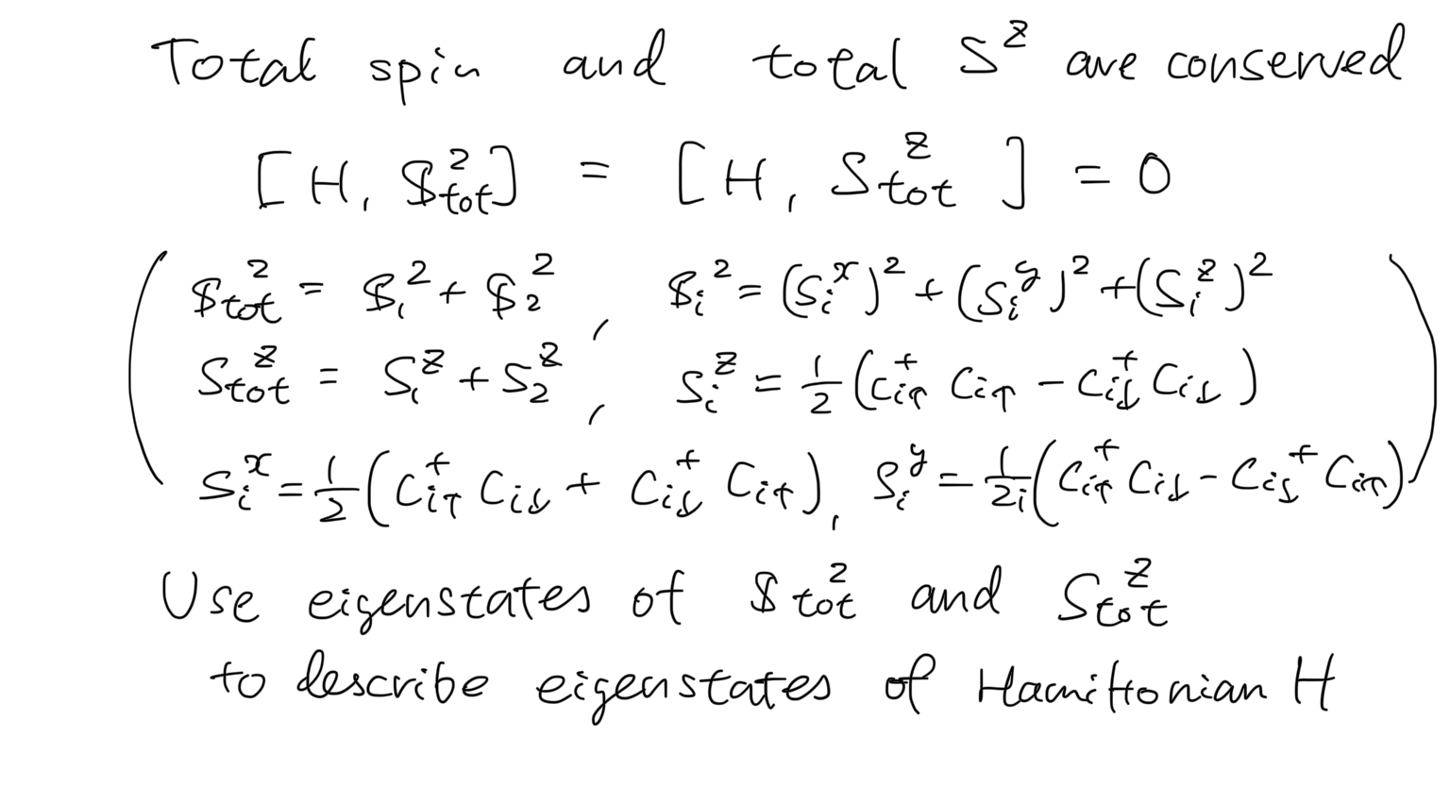
2-site Hubbard model

Slide 42
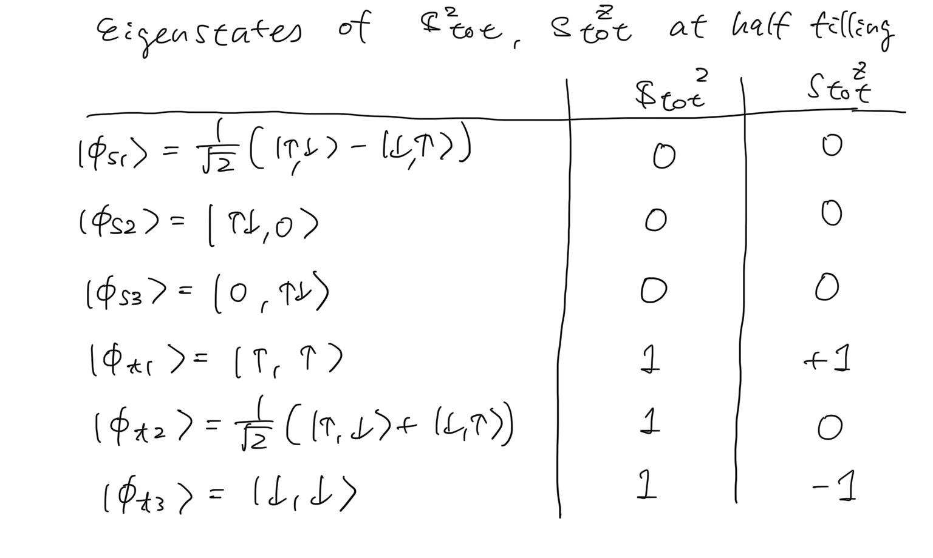
2-site Hubbard model

Slide 43
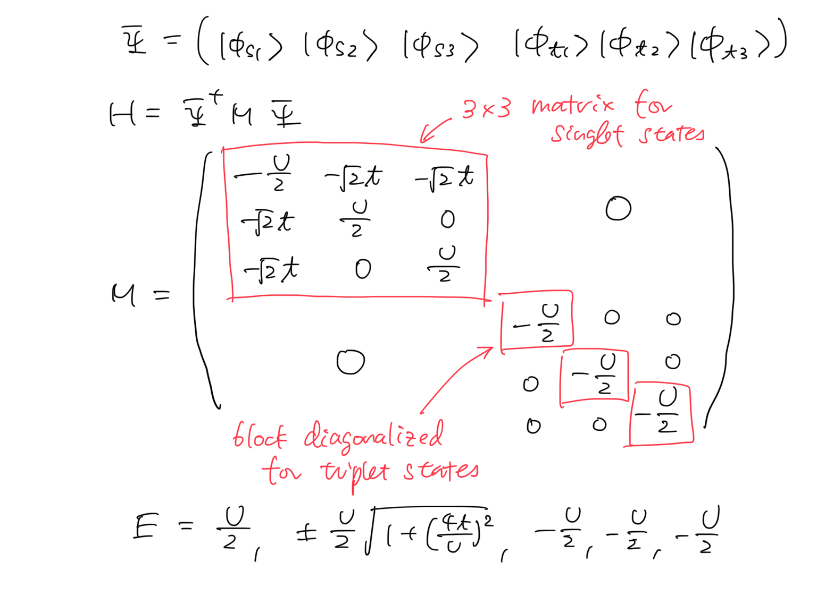
2-site Hubbard model

Slide 44
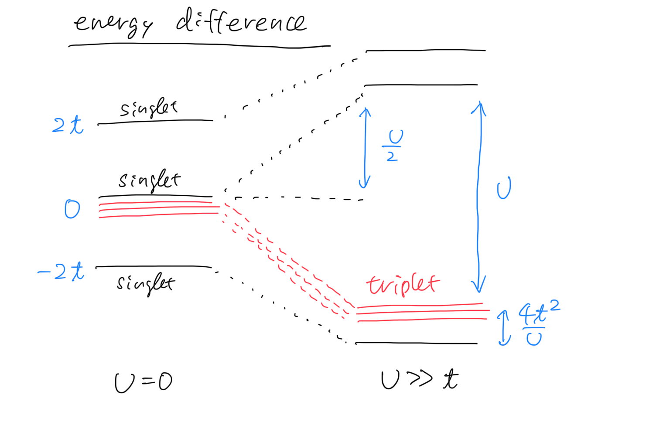
2-site Hubbard model

Slide 45
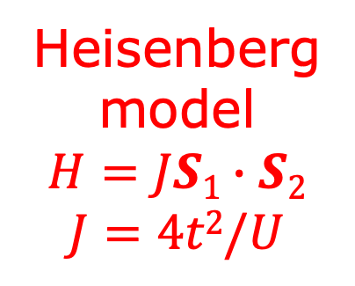
2-site Hubbard model
Heisenberg
model
$$H=JS1∙S2$$
$$J=4t2/U$$

Slide 46
Today’s summary
Brief review of itinerant electron systems
Electrons in crystals
Second quantization
Hubbard models
Solving models for simple cases
Noninteracting and atomic limits
Mean-field approximation
Exact diagonalization (2 sites)
→ Strong coupling limit: Heisenberg model (spin system)
Magnetism and quantum spin liquid
Spin models
Frustrated magnetism and quantum spin liquid
Kitaev honeycomb spin liquid
https://github.com/ryuikaneko/lecturenote_2024_condmat

